Slide 1

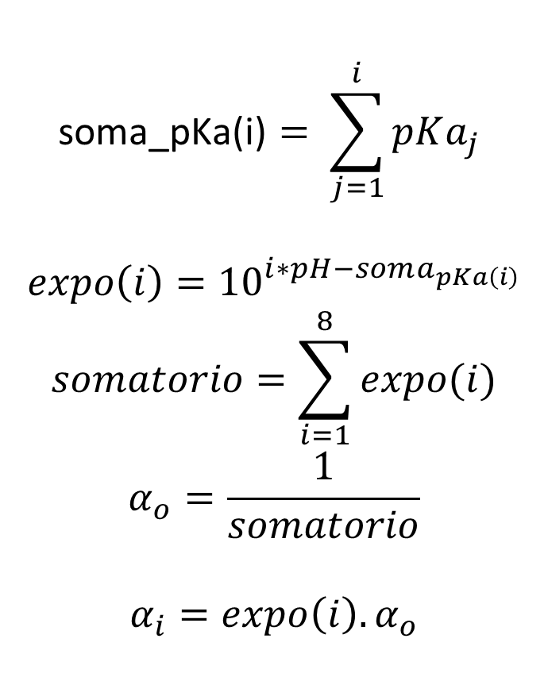
$$\text{soma}\text{_}\text{pKa}\text{(}\text{i}\text{)}= \sum_{j=1}^{i}{pKa_{j} }$$
$$expo\left(i\right)={10}^{i∗pH−soma_{pKa\left(i\right)}}$$
$$somatorio=\sum_{i=1}^{8}{expo(i)}$$
$$α_{o}=\frac{1}{somatorio}$$
$$α_{i}=expo\left(i\right). α_{o}$$
$$H_{3}PO_{4}$$

